Slide 1
University of Basrah – College of veterinary Medicine Department of Vet. Surgery and Obstitric
Affection Of the Penis & prepuce
Dr.Alaa A. Ibrahim

Slide 2
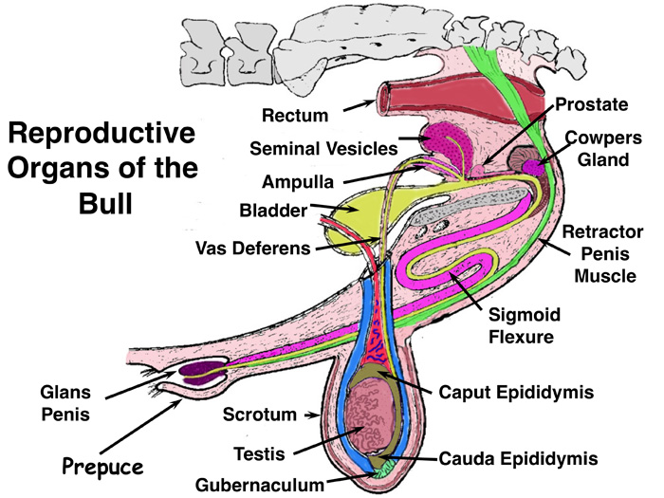
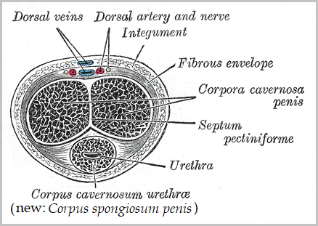
Anatomy

Slide 3
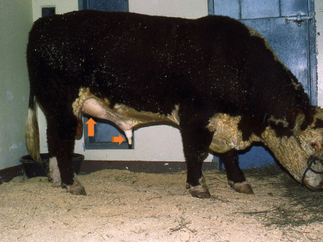
Penile hematoma
Hematoma and or its sequelae (abscess or adhesion) are commonest penile lesion
Etiology:-
Results from sudden or forceful bending of the erect penis
Penile deviation occur by sudden movement of the cow or by thrusting of the bull against the thigh of the cow before intromission is achieved, results in rupture of the tunica albuginea and hemorrhage

Slide 4
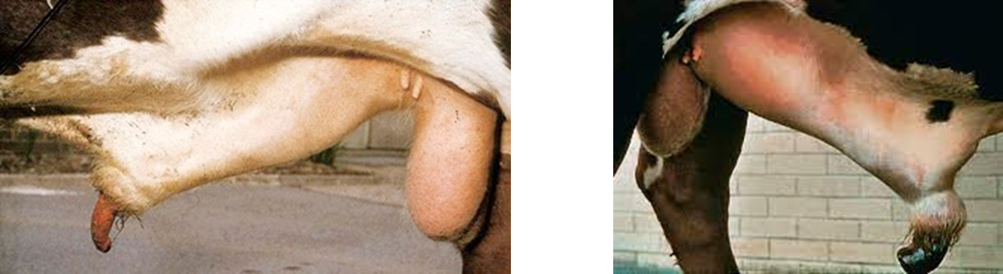
Repeated mating attempts by the bull may exacerbated hematoma
Hematoma site is always on dorsal or lateral aspect of penis ,distal to the distal curve of sigmoid flexor which is site of attachment of retractor penis M
During full erection , this part of penis comes to lies at the preputial orifice which act as fulcrum (بمثابة نقطة ارتكاز) against which bending force is exert

Slide 5
Clinical signs , diagnosis, prognosis of penile hematoma
Pain signs and arched back or alter gait (uncommon)
Protrusion of preputial lamina interna may occur indicating that penis is not withdrawn fully to its normal resting position
In some cases , paraphimosis (inability to withdraw the penis itself back into the prepuce)
The swelling located just cranial to the scrotum , reflecting the position of rupture site on partially withdrawn penis
It may not be obvious on inspection , requiring palpation to appreciate its full extent
Diagnosis :on clinical signs
Prognosis :Prognosis and clinical approach are influence by the size of hematoma

Slide 6
Treatment of penile hematoma
Conservative therapy :If the swelling is less than 15 cm in diameter , surgery is usually not required and the bull have a good prognosis for return to normal service behavior with conservative therapy
Conservative therapy include :
Removing bull from cow for 6 weeks
Daily hydrotherapy with cold water in acute stage after injury (4 days ) and warm water thereafter , coupled with vigorous massage in a deliberate attempt to move the skin , intervening layers of fascia, and the penis to minimize formation of adhesions between these structures, are recommended.
Hydrotherapy and massage should be continued for 3 weeks and NSAID may be beneficial first week

Slide 7
Surgical therapy of penile hematoma
Hematoma is over 15 cm in diameter, more extensive damage to the penile adnexa results, making restrictive adhesion formation and increase risk of abscess .These factors make prognosis and surgical therapy poor
Skin incision is should be small because large incision allow more opportunities for firm adhesion between skin and underlying tissue
Blood, blood clots, and serum are gently removed, with attention paid to hemostasis.
Any detectable rent in the tunica albuginea sutured with absorbable material, with care taken to avoid penetrating suture bites through the tunica albuginea which may result in leakage and failure to maintain erection

Slide 8
The skin incision should be left open. Postsurgical treatment should parallel the conservative approach to smaller hematomas.
Recurrence of the injury is common
Complications
Abscessation or extensive adhesions.

Slide 9
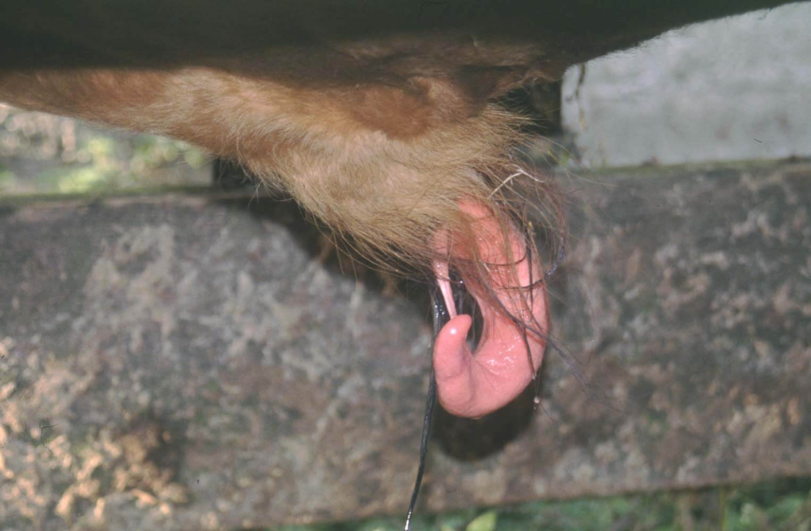
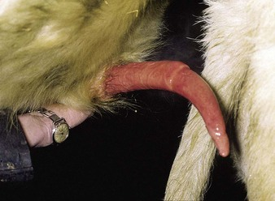
Deviation of the penis (corkscrew penis)
Most common form is spiral deviation
This condition result from slippage of apical ligament of the penis during erection , but before intromission, and thereby prevent intromission
Bull do not demonstrate this deviation at every service attempt but may prevent intromission in 50%-100% attempts
Formation of spiral in this way is normal at the point of ejaculation ,once the penis within the vagina

Slide 10
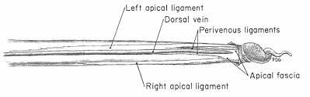
Apical ligament is a thickened fibrous band located dorsally near the free end of the penis
This ligament helps to hold penis straight for intromission and slips to the side after ejaculation and causes spiral deviation of the tip of the penis
Diagnosis :by observation of serving attempts

Slide 11
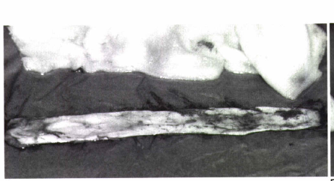
Treatment of spiral deviation
Surgical treatment involve anchoring the apical ligament of the penis so it cannot slip laterally and pull free part of the penis into a spiral or augmenting the apical ligament with an implant
For implantation, one large or multiple thin strips of fascia lata may be used; alternatively, synthetic fibers may be implanted.

Slide 12
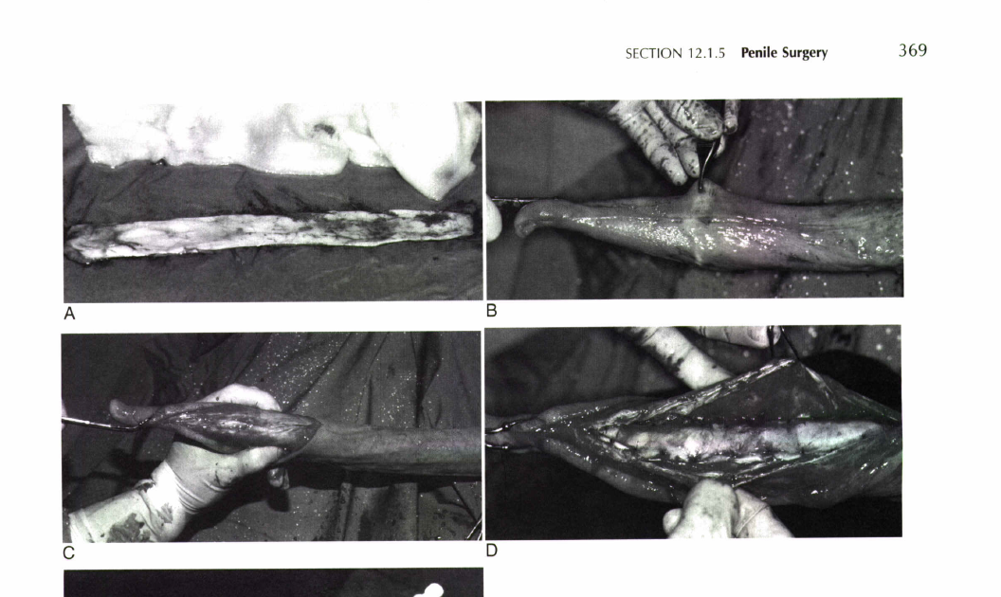
The penis is extended and held in place with penetrating towel clamps carefully placed into the distal part of the apical ligament to avoid penetration of the tunica albuginea
A longitudinal incision is made along the dorsal aspect of the penis
The incision is deepened until the apical ligament is exposed
The free edges of the apical ligament are identified, and carefully tacked to the underlying tunica albuginea, using multiple simple interrupted sutures of synthetic absorbable material.

Slide 13
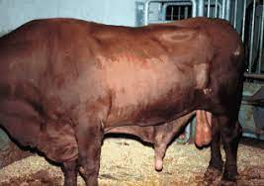
Erection failure
Result from leakage from corpus cavernosum penis which is a well-described cause of impotence in bull(impede erection.)
Vascular shunts usually communicate with the superficial penile vessels, but in some cases communication between the corpus cavernosum penis and corpus spongiosum penis occur
In this species , normal circulation of the corpus cavernosum penis is a closed system

Slide 14
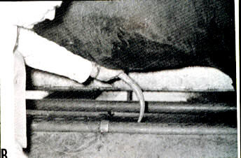
Cavernosal shunt must be differentiate from ventral deviation of the penis (rainbow penis قوس قزح) which is result from defect of the apical ligament of the penis.
In erection failure the penis is usually extended normally ,but erection is maintained only momentarily before the penis becomes flaccid and droops.
In the ventral deviation of the penis , the penis does not achieve its full length while straight and it remain rigid

Slide 15
Etiology of erection failure
Congenital presence of communicating vessel
Traumatic or iatrogenic penetration of the corpus cavernosum
Treatment
If there is communication between corpus cavernosum and corpus spongiosum , surgery is impossible
If the communication is with a superficial vessel, this vessel can be identified at surgery and firmly ligated at its point of emergence from the corpus cavernosum penis
For success of the corrective operation , 2-3 ml of dye (e.g methylene blue) can be injected slowly in the corpus cavernosum .

Slide 16
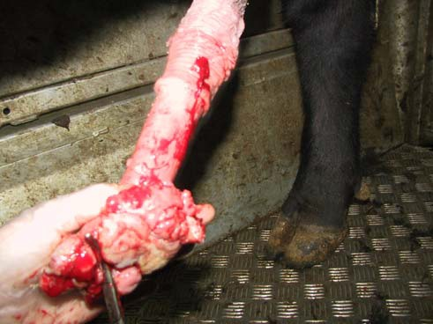
Penile tumors
Most common bovine penile tumor is fibropapiloma
Fibropapiloma interfere with breeding make intermission impossible in some cases and uncomfortable in other
Bleeding interfere with semen quality
Surgical remove of fibropapiloma to provide a rapid and certain return to use

Slide 17
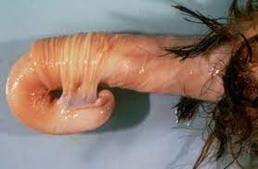
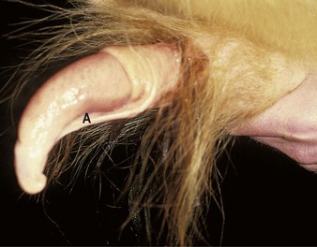
Persistent penile frenulum
Congenital band of connective tissue located between the glans penis and the prepuce (ventrum of the penis that extends from the prepuce to near the tip of the free portion of the penis)
Does not break down as the bull reach the puberty
Separation occurs at the time of puberty, starting from the tip of the penis and progressing caudally usually complete at 9 months of age.
The persistent frenulum prevent straight extension of the penis and during erection the elongated penis is pull into bow shape
Persistent frenulum is inherited disorder and can pass on to progeny

Slide 18
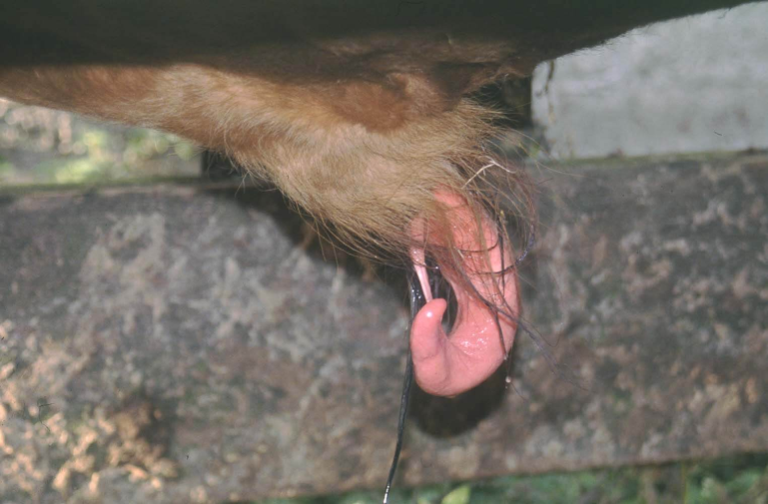
Treatment of Persistent penile frenulum
By transection of the persistent frenulum .Before transection , ligation of large vessel.
In young bull , penis often can be extended manually without or with little sedation. Application of dorsal nerve block is sufficient for perform this procedure.

Slide 19
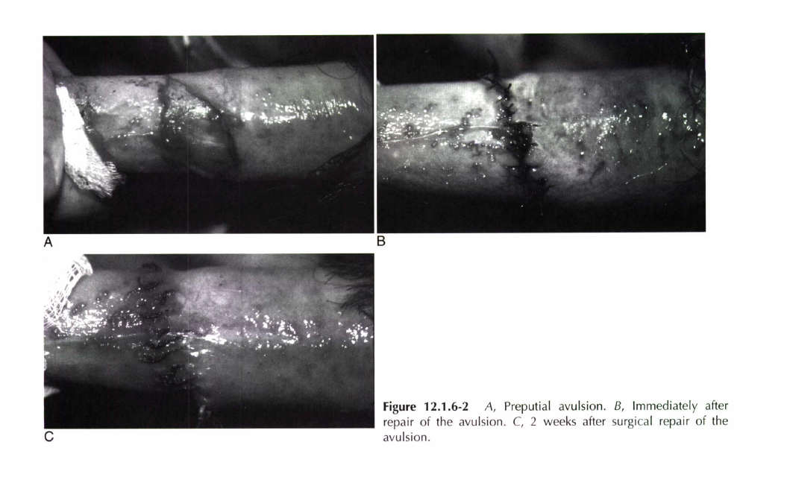
Preputial avulsion
Avulsion of the lamina interna of the prepuce from its attachment to the penile integument at the fornix or point of reflection
is the commonest injury to the penis and prepuce of bulls managed for the collection of semen for cryopreservation.
This form of injury is costly when it causes temporary suspension of semen collection from extremely valuable artificial insemination bulls that are under considerable pressure to produce semen

Slide 20
Etiology of Preputial avulsion
Etiology is not fully understood and occur in young bulls newly introduced for semen collection or reintroduced after a period of layoff
Observed only in bull whose semen is collected by artificial vagina
Sign : Bleeding after semen collection
Diagnosis can be confirmed by extending and examining of the penis (penis manually exteriorized after administration of 5mg xylazine )

Slide 21
Treatment
The injury may left to heal by second intension but convalescence is prolonged
Surgery is performed immediately after injury (on the same day) in order bull return to use with
few complications
Bull isolated from other bulls
and cows sexual stimulation
which provoke dehiscence of
surgical site

Slide 22
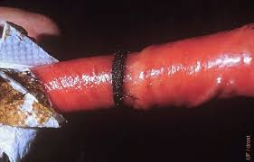
Preputial hair ring
Ring of preputial hair may entrap the penis
This condition is usually spontaneously resolved but the hair may strangulate and damage the penis
Treatment of the lesion is depend on the judge of the surgeon but some cases may treated as preputial avulsion

Slide 23
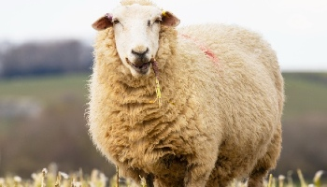
Preputial erosion
Decubital lesion occur dorsal to preputial orifice between the prepuce and abdominal wall
Affect heavy show rams because they are recumbent much of time , pressure of the preputial orifice on abdominal wall results in a chronic ulcer.
This erosion is resistant to conservative treatment and only surgical resection is treatment option.

